Slide 1
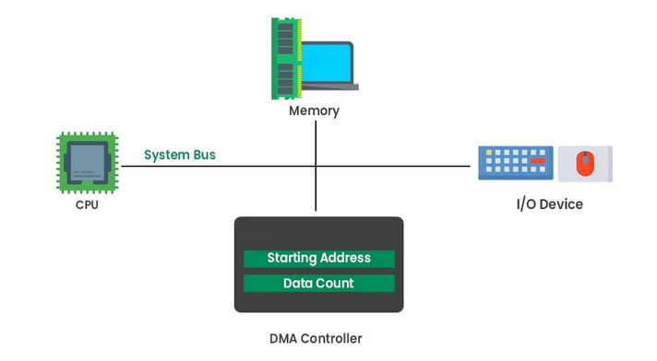
Direct Memory Access (DMA)
Direct memory access (DMA) is a method that allows an input/output (I/O) device to send or receive data directly to or from the main memory, bypassing the CPU to speed up memory operations. The process is managed by a chip known as a DMA controller (DMAC).

Slide 2
Why it is needed?
A computer's system resource tools are used for communication between hardware and software. The four types of system resources are:
I/O addresses
Memory addresses
Interrupt request numbers (IRQ)
Direct memory access (DMA) channels
DMA channels are used to communicate data between the peripheral device and the system memory.

Slide 3
Why it is needed?
Without DMA, during I/O operation, the whole CPU is occupied for read and write operation, and thus is unavailable for other works.
With DMA, CPU can do other works while the transfer is in progress.
DMA is used in disk drives, graphics cards, network cards and sound cards.

Slide 4
How DMA operations are performed?
Initially, when any device has to send data between the device and the memory, the device has to send DMA request (DRQ) to DMA controller.
The DMA controller sends Hold request (HRQ) to the CPU and waits for the CPU to assert the HLDA.
Then the microprocessor tri-states all the data bus, address bus, and control bus. The CPU leaves the control over bus and acknowledges the HOLD request through HLDA signal.
Now the CPU is in HOLD state and the DMA controller has to manage the operations over buses between the CPU, memory, and I/O devices.

Slide 5
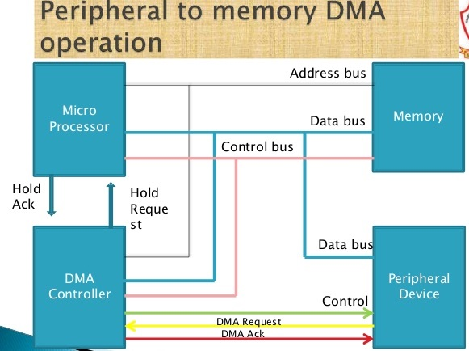
How DMA operations are performed?

Slide 6
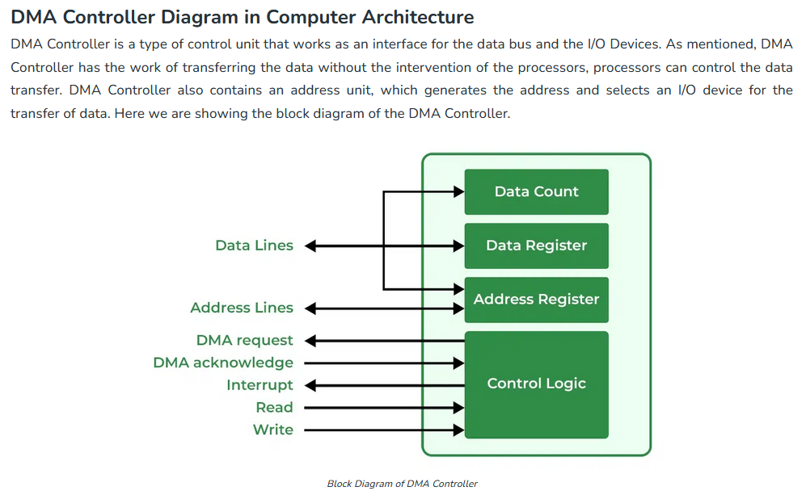

Slide 7
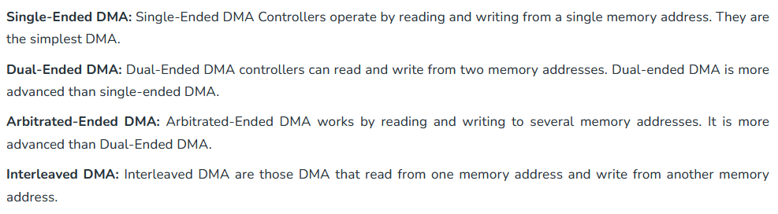
Types of Direct Memory Access

Slide 8
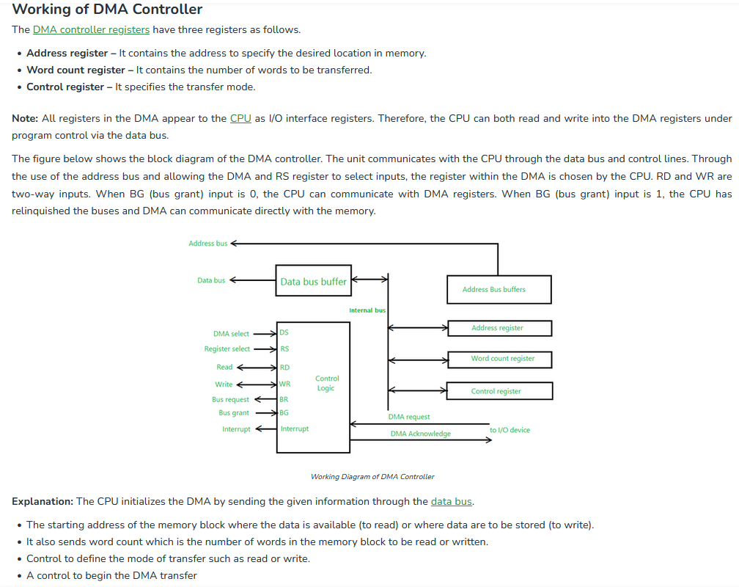

Slide 9
DMA Transfer Modes
Burst or block transfer DMA
Cycle steal or single byte transfer DMA.
Transparent or hidden DMA.

Slide 10
DMA Transfer Modes
1) Burst or block transfer DMA
It is the fastest DMA mode. In this two or more data bytes are transferred continuously.
Processor is disconnected from system bus during DMA transfer. N number of machine cycles are adopted into the machine cycles of the processor where N is the number of bytes to be transferred.
DMA sends HOLD signal to processor to request for system bus and waits for HLDA signal.
After receiving HLDA signal, DMA gains control of system bus and transfers one byte. After transferring one byte, it increments memory address, decrements counter and transfers next byte.
In this way, it transfer all data bytes between memory and I/O devices. After transferring all data bytes, the DMA controller disables HOLD signal & enters into slave mode.

Slide 11
Burst or block transfer DMA
Pros:
Most Efficient way for DMA Transfer.
Cons:
Rate of DMA Transfer will be less.
CPU won’t be blocked entire time.

Slide 12
DMA Transfer Modes
2) Cycle steal or single byte transfer DMA.
In this mode only one byte is transferred at a time. This is slower than burst DMA.
DMA sends HOLD signal to processor and waits for HLDA signal on receiving HLDA signal, it gains control of system bus and executes only one DMA cycle.
After transfer one byte, it disables HOLD signal and enters into slave mode.
Processor gains control of system bus and executes next machine cycle. If count is not zero and data is available then the DMA controller sends HOLD signal to the processor and transfer next byte of data block.

Slide 13
DMA Transfer Modes
3) Transparent or Hidden DMA transfer
Processor executes some states during which is floats the address and data buses. During this process, processor is isolated from the system bus.
DMA transfers data between memory and I/O devices during these states. This operation is transparent to the processor.
This is slowest DMA transfer. In this mode, the instruction execution speed of processor is not reduced. But, the transparent DMA requires logic to detect the states when the processor is floating the buses.

Slide 14
Transparent or Hidden DMA transfer
Pros:
CPU will not be blocked at all.
Cons:
Slowest DMA transfer rate.

Slide 15
Advantages of DMA Controller
Data Memory Access speeds up memory operations and data transfer.
CPU is not involved while transferring data.
DMA requires very few clock cycles while transferring data.
DMA distributes workload very appropriately.
DMA helps the CPU in decreasing its load.
Disadvantages of DMA Controller
Direct Memory Access is a costly operation because of additional operations.
DMA suffers from Cache-Coherence Problems.
DMA Controller increases the overall cost of the system.
DMA Controller increases the complexity of the software.

Slide 16
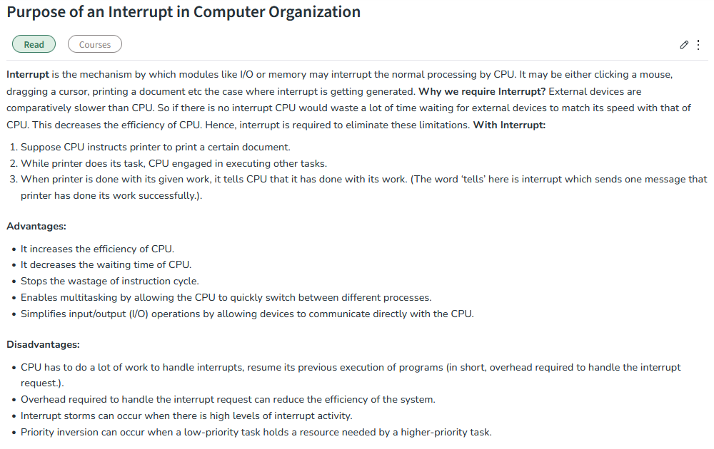

Slide 17
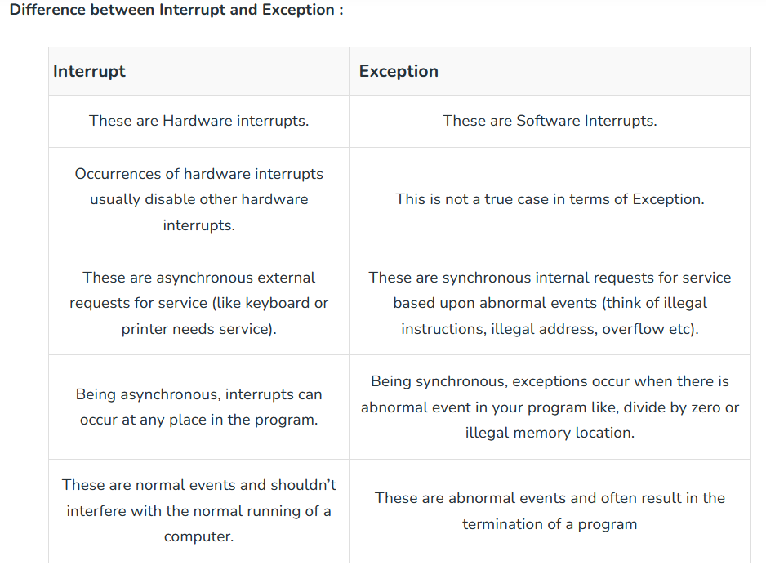

Slide 18
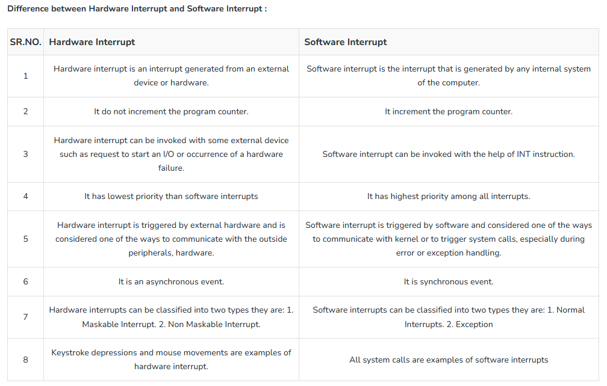

Slide 19
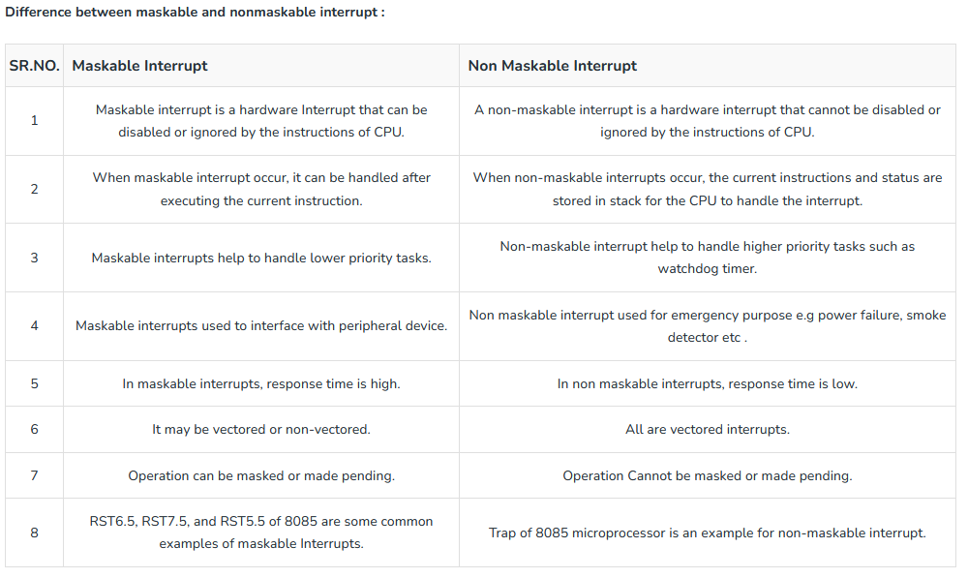

Slide 20
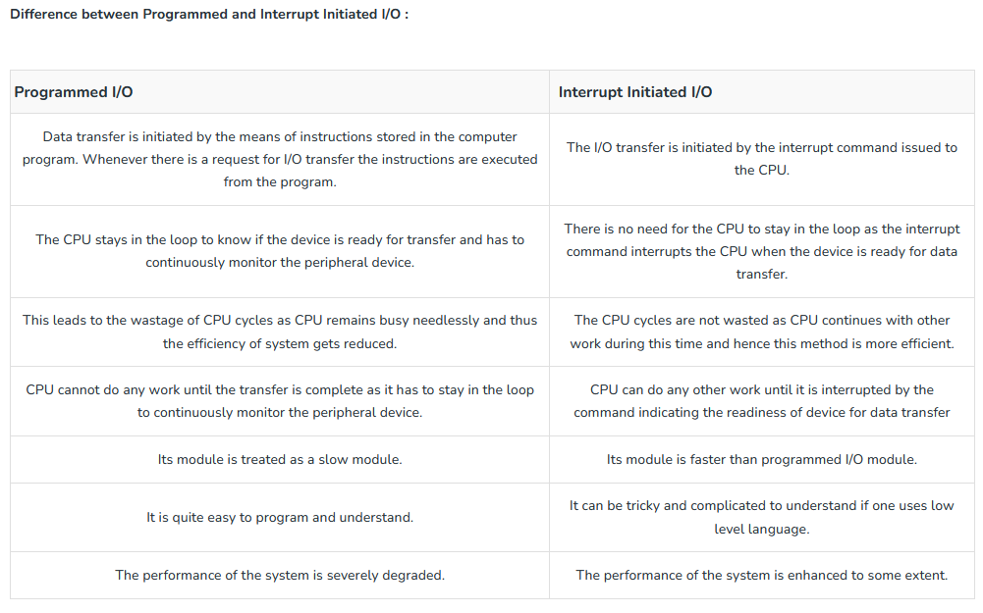

Slide 21
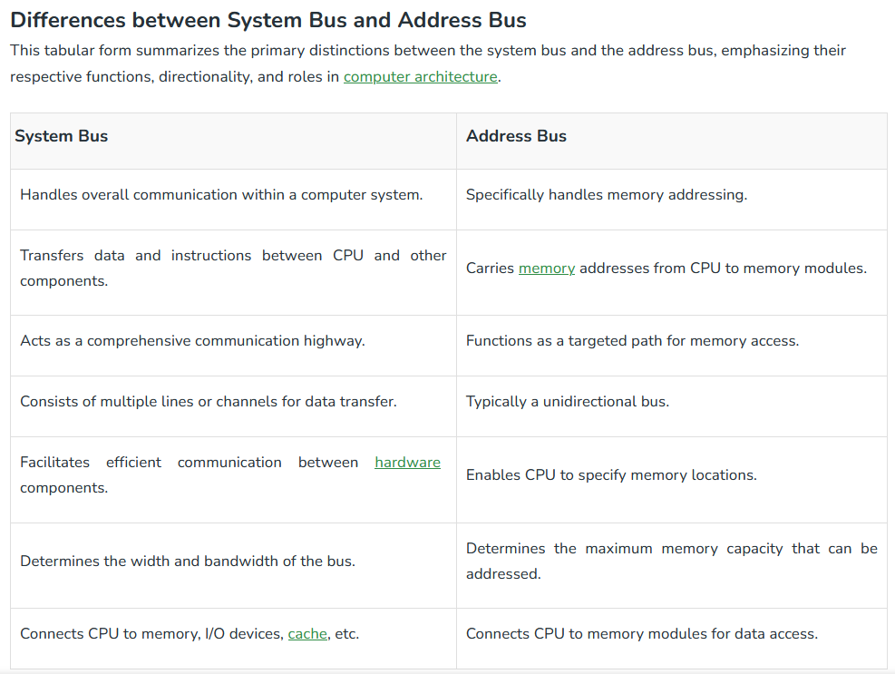

Slide 22
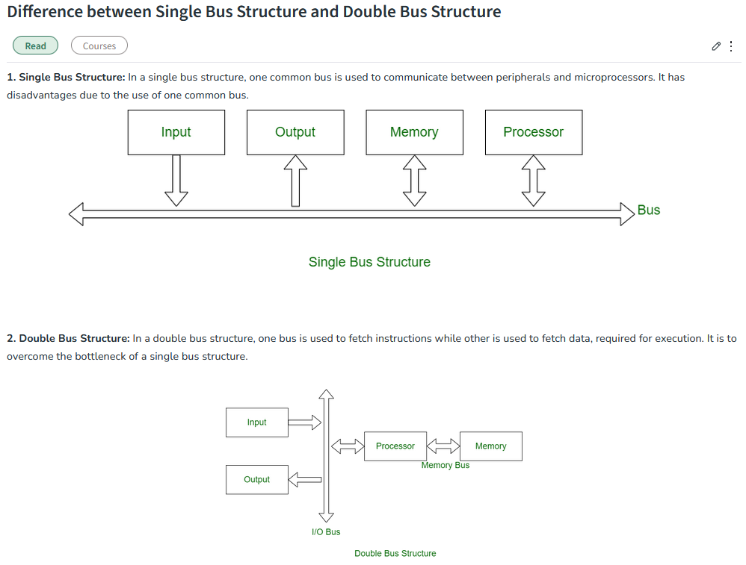

Slide 23
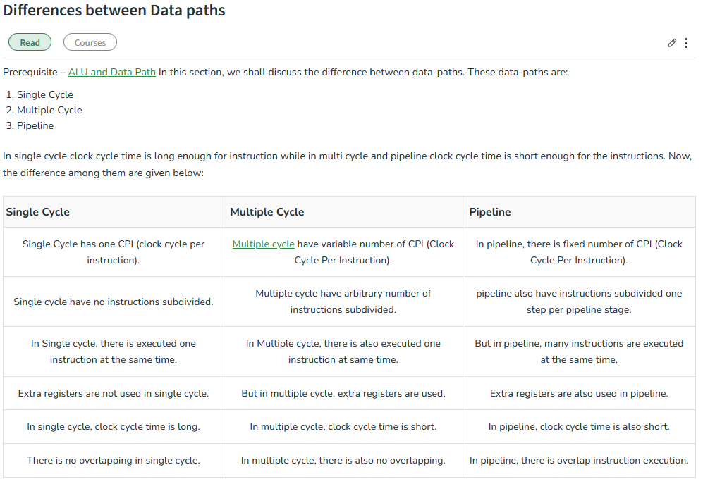

Slide 24
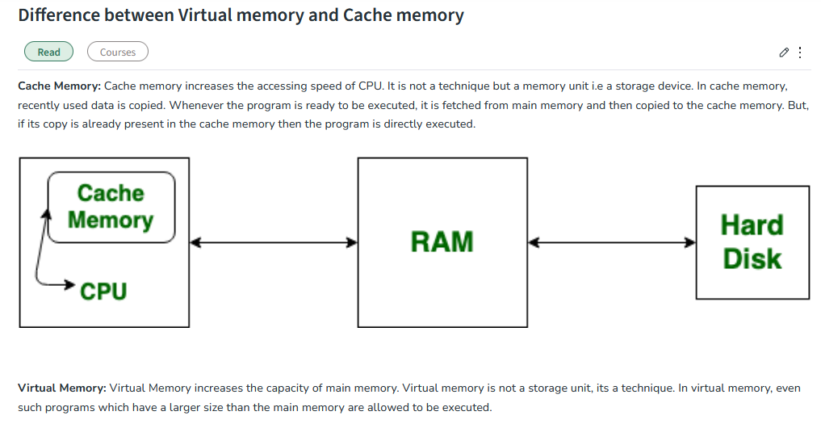

Slide 25
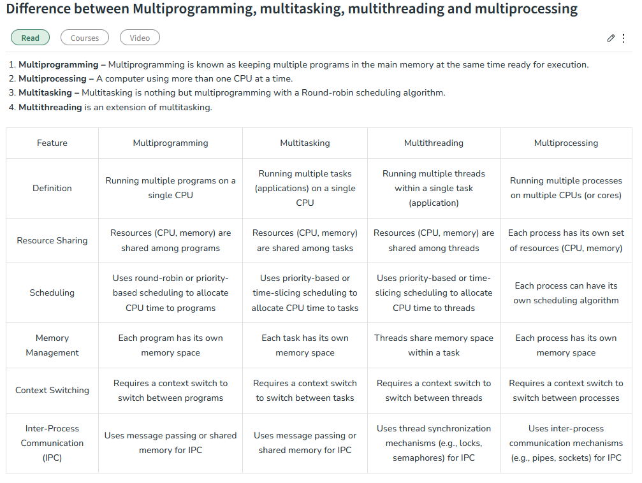

Slide 26
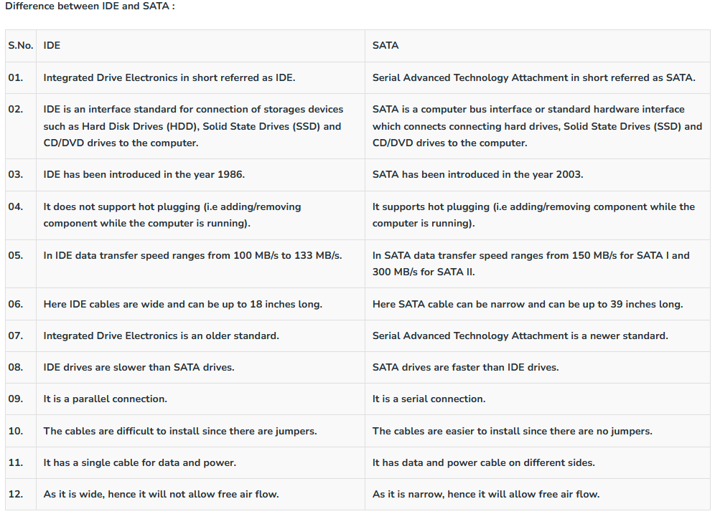

Slide 27
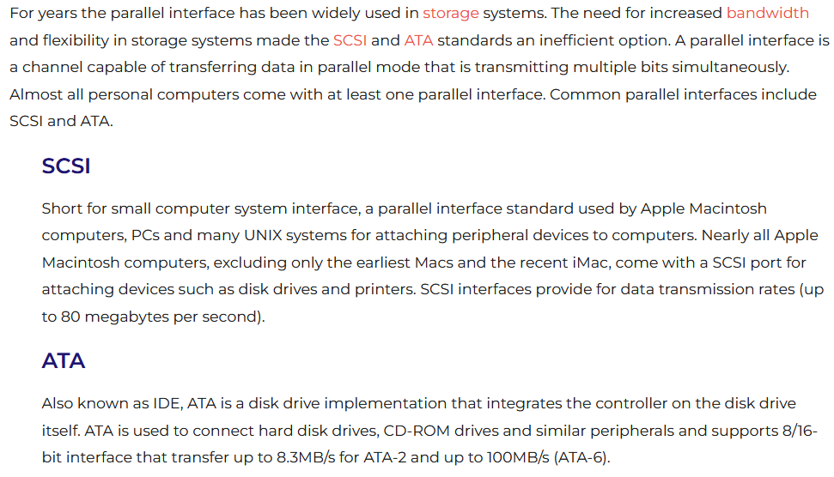

Slide 28
